Slide 1
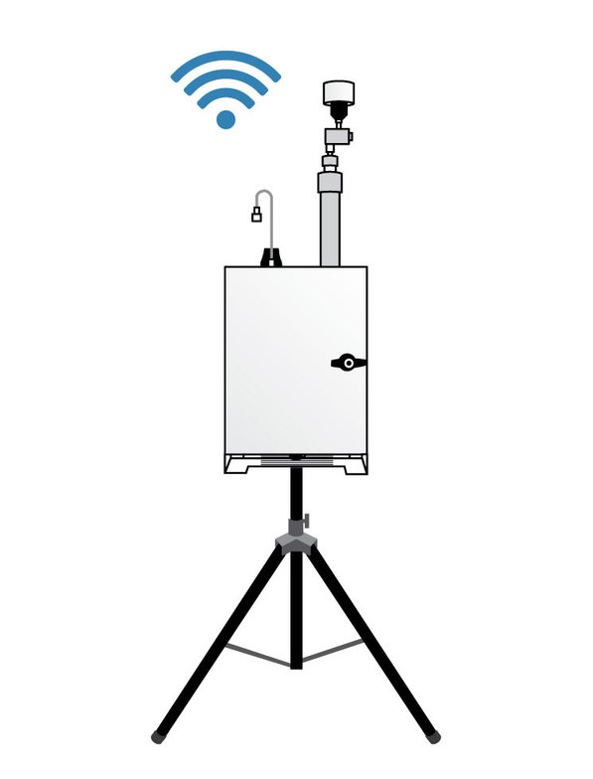
AIR QUALITY MONITORING

Slide 2
Phase -2
Project
INNOVATION
M.VIMAL RAJ 422621106301 au422621106301

Slide 3

Predictive modeling
Predictive modeling to forecast air quality involves using historical data and modeling techniques to predict future air quality conditions. By analyzing factors such as pollutant levels, weather patterns, and other environmental variables, predictive models can provide insights into future air quality trends. This helps in proactive planning, decision- making, and implementing measures to mitigate air pollution and protect public health.

Slide 4

predictive modeling to forecast air quality
The autoregressive (AR) model,
The autoregressive integrated moving average (ARIMA) model,
The gray model,
The multiple linear regression (MLR) model

Slide 5
Devices used forecast to air quality
Air quality sensors
Weather stations
Satellite imagery
Atmospheric monitoring equipment.

Slide 6
Weather station
Air quality sensor
Satellite imagery
Atmospheric monitoring equipment

Slide 7
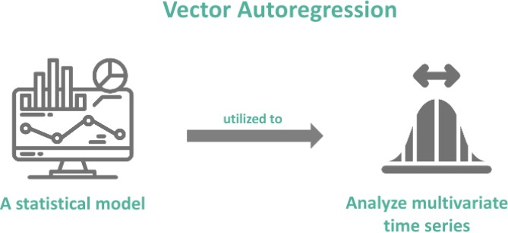
MODELS:
1)Autoregressive (AR) model
Defnition:
An autoregressive model is a process used to
predict the future based on accumulated data from the past.

Slide 8
Working:
Autoregressive models, also known as AR models.
Are a type of predictive modeling technique used to forecast future values based on past
observations.
In an autoregressive model, the future value of a variable is estimated based on its
previous values.
The model assumes that the current value is linearly dependent on its past values and
possibly some random error term.
By analyzing the patterns and relationships in the historical data, autoregressive models
can make predictions about future trends.
It's a useful tool in time series analysis and forecasting.

Slide 9
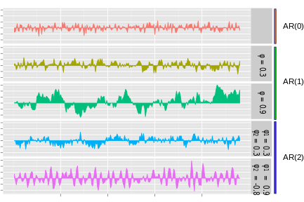
Graph:

Slide 10
CODE:
import pandas as pd
from statsmodels.tsa.ar_model import AutoReg from sklearn.metrics import mean_squared_error
data = pd.read_csv('your_data.csv', parse_dates=['Date'], index_col='Date') train = data['1950-01-01':'1960-12-31']
test = data['1960-01-01':]
p = 3
model = AutoReg(train['AQI'], lags=p) results = model.fit()
predictions = results.predict(start=len(train), end=len(train)+len(test)-1, dynamic=False)
mse = mean_squared_error(test['AQI'], predictions) print(f'Mean Squared Error: {mse:.2f}')
import matplotlib.pyplot as plt plt.plot(test['AQI'], label='Actual') plt.plot(predictions, label='Predicted') plt.legend()
plt.show()

Slide 11
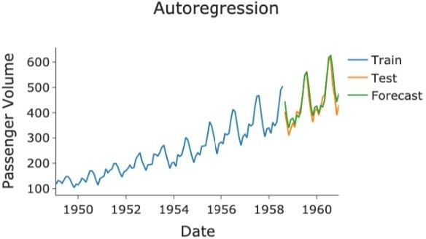
OUTPUT:

Slide 12
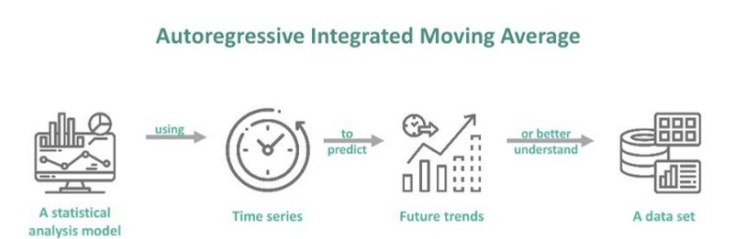
2)Autoregressive integrated moving average model
Defnition:
ARIMA is an acronym for “autoregressive integrated moving average.” It's a model used in statistics and econometrics to measure events that happen over a period of time.

Slide 13
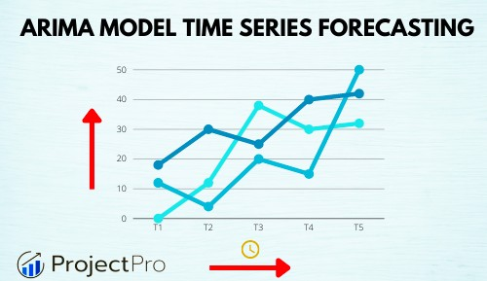

WORKING OF ARIMA MODEL
Autoregressive (AR) Component:
The "AR" part of ARIMA refers to the autoregressive component. It models the relationship between an observation and several lagged observations (previous time steps).
It assumes that the value of a variable today is related to its past values. Integrated (I) Component:
The "I" term stands for integration. It refers to the differencing of raw observations (subtracting an observation from the previous observation) in order to make the time series stationary. Stationarity is important for ARIMA models.
Moving Average (MA) Component:
The "MA" part involves modeling the relationship between an observation and a residual error from a moving average model applied to lagged observations.
The parameters p, d, and q are used to determine the order of the AR, I, and MA components, respectively:
p is the order of the autoregressive component, which represents the number of lag observations included in the model.
d is the degree of differencing, or the number of times the data is differenced to achieve stationarity.
q is the order of the moving average component, which represents the number of lagged forecast errors in the prediction equation.
The process of selecting appropriate values for p, d, and q is known as model identification.

Slide 14
CODE:
import pandas as pd import numpy as np
from statsmodels.tsa.arima.model import ARIMA import matplotlib.pyplot as plt
data = pd.read_csv('air_quality_data.csv') data['Date'] = pd.to_datetime(data['Date']) data.set_index('Date', inplace=True)
plt.figure(figsize=(10, 6)) plt.plot(data['AirQuality']) plt.title('Air Quality Data') plt.xlabel('Date') plt.ylabel('Air Quality') plt.show()
statsmodels.tsa.stattools import adfuller
result = adfuller(data['AirQuality']) print('ADF Statistic:', result[0]) print('p-value:', result[1])
data_diff = data['AirQuality'].diff().dropna()
model = ARIMA(data['AirQuality'], order=(5,1,0)) # Adjust order as needed results = model.fit()
forecast_steps = 12 Adjust as needed forecast = results.get_forecast(steps=forecast_steps)
forecasted_data = forecast.predicted_mean
plt.figure(figsize=(10, 6)) plt.plot(data.index, data['AirQuality'], label='Observed')
plt.plot(forecasted_data.index, forecasted_data, color='red', label='Forecasted') plt.title('Air Quality Forecast')
plt.xlabel('Date') plt.ylabel('Air Quality') plt.legend()
plt.show()
print(forecasted_data)

Slide 15
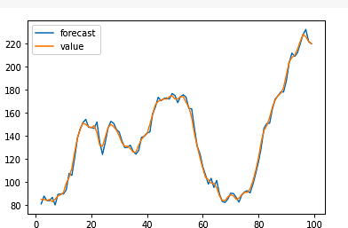
OUTPUT:

Slide 16
3) Gray model
Defnition:
Airquality monitoring, a "gray model" refers to a type of mathematical model used to forecast or predict air quality parameters. This model is
termed "gray" because it falls between white (complete information) and black (no information). Gray models are typically employed when there is limited or incomplete data available.
These models utilize a combination of differential equations and historical data to make predictions about air quality. They can be particularly useful in
situations where traditional models may not be applicable due to data constraints. It's important to note that the effectiveness of a gray model is contingent on the quality and relevance of the available data.

Slide 17
Code:
import pandas as pd
from sklearn.model_selection import train_test_split from sklearn.ensemble import RandomForestClassifier from sklearn.metrics import accuracy_score
data = pd.read_csv('air_quality_data.csv') X = data[['feature1', 'feature2', 'feature3', ...]]
y = data['air_quality_code'] # Labels
X_train, X_test, y_train, y_test = train_test_split(X, y, test_size=0.2, random_state=42) model = RandomForestClassifier()
model.fit(X_train, y_train)
y_pred = model.predict(X_test) accuracy = accuracy_score(y_test, y_pred)
def classify_gray(prediction): if 50 <= prediction <= 100:
return "Code Gray"
else:
return "Other Code"
new_data = pd.read_csv('new_air_quality_data.csv') new_X = new_data[['feature1', 'feature2', 'feature3', ...]] new_predictions = model.predict(new_X)
new_codes = [classify_gray(pred) for pred in new_predictions]

Slide 18
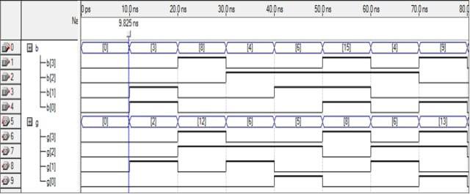
OUTPUT:

Slide 19
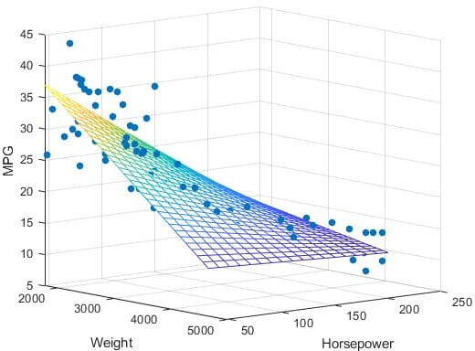
4) Multiple linear regression (MLR)
Defnition:
Multiple linear regression is a regression model that estimates the relationship between a quantitative dependent variable and two or more independent variables using a straight line.

Slide 20
Code:
import numpy as np
import matplotlib as mpl
from mpl_toolkits.mplot3d import Axes3D import matplotlib.pyplot as plt
def generate_dataset(n):
x = []
y = []
random_x1 = np.random.rand() random_x2 = np.random.rand() for i in range(n):
x1 = i
x2 = i/2 + np.random.rand()*n x.append([1, x1, x2])
y.append(random_x1 * x1 + random_x2 * x2 + 1) return np.array(x), np.array(y)

Slide 21
return np.array(x), np.array(y)
x, y = generate_dataset(200) mpl.rcParams['legend.fontsize'] = 12 fig = plt.figure()
ax = fig.add_subplot(projection ='3d')
ax.scatter(x[:, 1], x[:, 2], y, label ='y', s = 5) ax.legend()
ax.view_init(45, 0) plt.show()

Slide 22
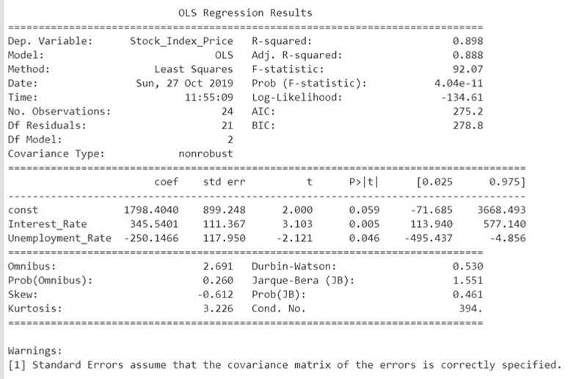

OUTPUT:

Slide 23


